Slide 1
Functional Programming
Functional-Style programming in JS

Slide 2

Goal
Introduction to Functional Programming
Understand key concepts
Get you to think Functionally

Slide 3
What did my team got out of FP?
Modular code
Single Responsibility Principle
Clean code
Reusability
Changes are isolated
Highly testable code
Notes:
Book: clean code by Robert C. Martin

Slide 4

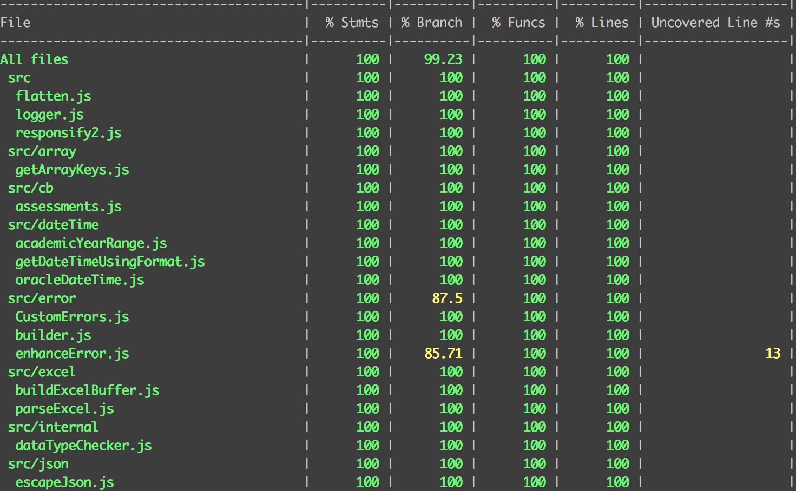
Our team code coverage
Notes:
Code coverage explanation:
https://confluence.atlassian.com/clover/about-code-coverage-71599496.html

Slide 5


History of JS
Notes:
Brendan Eich built it in 90’s and back then Java was the thing; OOP was the buzz word
Using Prototypical inheritance, you can code JS as OOP

Slide 6
JavaScript Programming Model
Supports OOP
FP model

Slide 7
Support for FP
Functions as first-class citizen
Closure
Higher order function
Notes:
Function as first class citizen which enables you to write higher order function
These above features are needed to support the functional modal

Slide 8
Few Misses
Lazy Evaluation
No Built in immutable data
Notes:
I think the generator is the path forward to say that the language supports lazy evaluation
Linter helps you avoid modifying the input to be sort of immutable but sometime APIs does it under the hood. For eg array.sort
you can use object freezing but it is shallow freezing which means you must freeze recursively

Slide 9
Can we be FP-er in JS?
Notes:
- The language supports the construct that are required to be functional even thought there are few misses
For our purpose JS is functional and we can write functional style of code
Just have to very careful when using object types such as object, array etc.

Slide 10
What is FP?
Not a new tool or an API
A way to think about how code should be structured to make data flow much more obvious and help your reader follow your thinking
Notes:
- Helping your reader (which can be your future self) - lot of time is spent reading unless you starting from scratch
- We will see some code today and you might be surprised and say but I already knew that

Slide 11
Fundamental concepts
Declarative Programming
Pure functions
Referential Transparency
Immutability

Slide 12
Declarative vs. Imperative
Declarative: ask what you want
Imperative: specify how it’s done
Notes:
- Looping over an array using foreach is imperative while using methods such as forEach is more declarative
Best example in JavaScript is object destructuring; All you do is tell what properties you want to read rather then specifying how to read
SQL is another example of declarative programming
But under the hood to support declarative nature, imperative code are working harder.
When you have declarative flow of code you will simply start to read your code as high level instructions of what is being done; We will see how your code reads out in an example soon
(from code example show how the code is declarative)

Slide 13
Pure functions
Use input params only
No side effect
Notes:
Given the same arguments, your function will always return the same result no matter how many times it’s invoked. This is possible only when your code doesn’t depend on external factors such as external variable or I/O etc. The major culprit is usually ‘this’ keyword. If you rely on this keyword, most likely you do not have pure functions.
This function also should not cause any observable side effect such as modifying variables outside its scope or even the arguments that are not primitive, I/O etc.
In my experience, if you thing you have pure functions, try writing unit test. If you have to do any setup of data or mocks instead of simply calling it with the needed params, you have impure functions

Slide 14
Referential Transparency
Same result for same input
Mathematically provable code
Substitutability
Notes:
In mathematics, RT is the property that lets you replace an expression with its value and not change the result of the entire computation.
Direct result of having pure function. This should be self evident. Example Math.sqrt(4) will always yield 2.
This is the most desirable behavior because you can replace the part of your code with output of a function to reason about. How useful is this when debugging a program?
Makes writing unit test so much easier
You can prove your code works because of this feature, like proving it works mathematically.
Always AIM for referential transparency which means no more “this”

Slide 15
Immutability
Avoid side effect
Spread operator
Libraries
Notes:
Primitives are immutable eg string, integer etc.
Arrays etc. are mutable; functions as array.sort creates side effect by modifying the original array, side effect.
Your program should never modify input params; if you start to break away from immutability you cannot reason about your code because you will loose referential transparency. Bug can be hidden anywhere at this point.
Always write immutable code. The new spread operator can help you with this while being declarative (but can have performance cost for huge data sets)
Libraries like immutable js can help.
Goal is to build immutable programs based on the building blocks of pure functions
Once you have pure functions that rely only on input your code becomes very easy to reason about and have more chances of being re-used
Write your code so that impure code are and pure code are always separated; no exceptions. That way you can reason about your code and say where possible bug source is
Additional thought: This is where const adds confusion; const creates a read-only reference to a value. It does not mean the value it holds is immutable, just that the variable identifier cannot be reassigned

Slide 16
Example
function add(x, y) {
return x + y;
}
let someThing = 1 + add(2, 3);
Notes:
Prepack tries to figure this out and optimize your code.
Pure
RT
Immutable

Slide 17
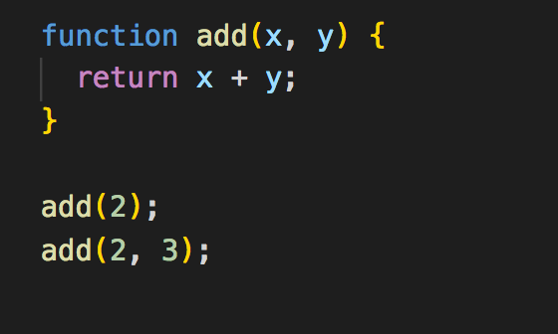
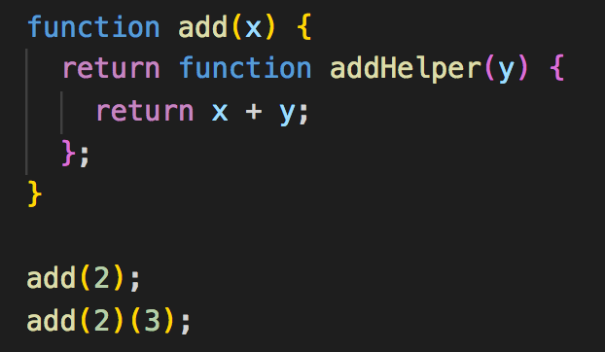
Currying
Notes:
Converting a function that converts n argument functions into a stepwise sequence of unary function by suspending execution until all arguments are provided
Closure and higher order function enables currying technique; so it’s really imperative that you understand this
It’s hard to see why its useful but just hang on to it and we will see why its important when we look at some real code
BTW: One of the practical use cases of this technique of using higher order function is avoiding global variables; we can also optimize lambda by using this manual currying process
Other important Things that exists: partial application

Slide 18
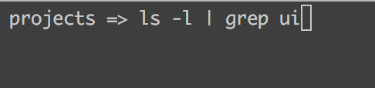
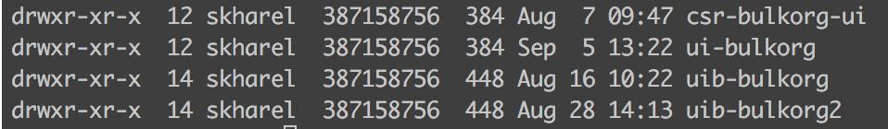
Piping for Composing
Notes:
Suppose I am in my projects directory and & I want to see how many UI projects are here
We talked about writing modular code
But at some point we need to able to use all these modular code to build one big program that does something useful
Pipe is the utility that will help us compose these modular function
BTW using term pipe for composing might be a little confusing because there is also separate utility called compose
Here the first function ls –l produces someoutput; it’s output will be input to the grep. For the grep function we provided argument ui

Slide 19

Live coding
Notes:
Using currying & pipe we will code

Slide 20

Being Functional
Building a pipeline by composing functions which is waiting for data
https://medium.com/@sagar_kharel84/getting-functional-4bb8f1da73ab

Slide 21
How to start?
if-else
for
Functional ifElse
Map/reduce
Stay Declarative
Be point free
Data last
Think pipeline
Notes:
Its quite hard to refactor large code bases immediately. So where do I start?
Really want to write a code that is easy to write, understand and test? You have to give FP a chance.

Slide 22
Library
RamdaJS
Sanctuary

Slide 23
Books
Free ones:
https://github.com/getify/Functional-Light-JS
https://mostly-adequate.gitbooks.io/mostly-adequate-guide/
Functional Programming in JavaScript (https://bit.ly/1QGYZVS)
Mastering JavaScript Functional Programming (https://bit.ly/2GobtHf)

Slide 24
Useful links
JS History:
https://brendaneich.com/2008/04/popularity/
FDIV Flaw:
http://www.trnicely.net/#PENT
http://www.trnicely.net/pentbug/pentbug.html
An Industrially Effective Environment for Formal Hardware Verification
http://www.cs.ox.ac.uk/tom.melham/pub/Seger-2005-IEE.pdf
Similar to this presentation
https://medium.com/@sagar_kharel84/getting-functional-4bb8f1da73ab

